Slide 1
Autopilot literature review
Cairo University - Faculty of Engineering
Aerospace Department
Notes:
We designed this template so that each member of the project team has a set of slides with its own theme. Members, here’s how you add a new slide to just your set:
Mark where you want to add the slide: Select an existing one in the Thumbnails pane, click the New Slide button, then choose a layout. The new slide gets the same theme as the other slides in your set.
Careful! Don’t annoy your fellow presenters by accidentally changing their themes. That can happen if you choose a different theme from the Design tab, which changes all of the slides in the presentation to that look.

Slide 2
Team 15
Submitted To: Eng . Mahmoud Elewa
Name | Sec | Bn
Abdallah Ahmed Abdallah | 1 | 31
Mohamed Rajeh Mohamed | 2 | 10
Mohamed Rabie Walaan | 2 | 11
Ahmed Ramadan Kamal | 1 | 5
Mohamed Ahmed Mohamed Khalil | 2 | 5
Mohamed Emad Mahmoud | 2 | 20

Slide 3
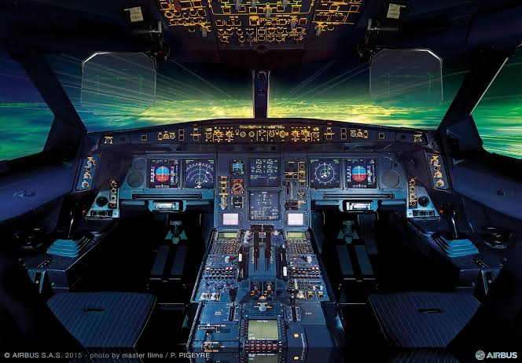
Introduction
Definition of Autopilot: A system that controls an aircraft under certain conditions using hydraulic, mechanical, and electronic systems.
Purpose: Helps pilots manage flight, maintain stability, and follow a predefined route.
Used mostly in passenger aircraft.

Slide 4
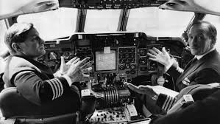
First Autopilot Invention
Invented in 1912 by Elmer Ambrose Sperry.
First tested successfully in 1914
Used gyroscopes to maintain stability.

Slide 5
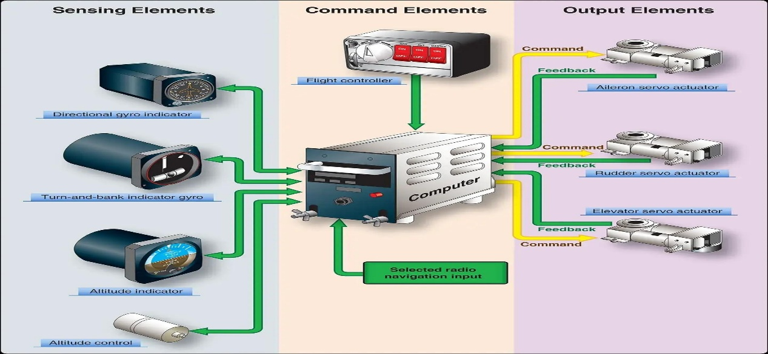
Autopilot Buttons & Controls
Key controls:
FD (Flight Director)
HDG (Heading)
NAV (Navigation)
ALT (Altitude)
APPR (Approach)
LVL (Level flight)

Slide 6
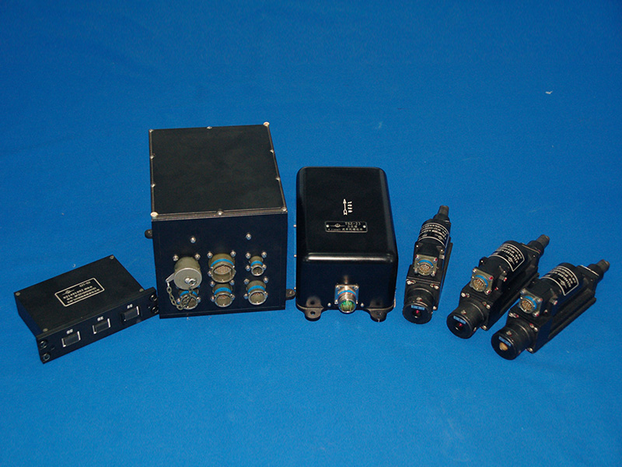
Autopilot vs. Stability Augmentation System (SAS)
SAS: Helps maintain stability (used in helicopters).
Autopilot: Manages full control of flight.
Both improve safety and efficiency.

Slide 7
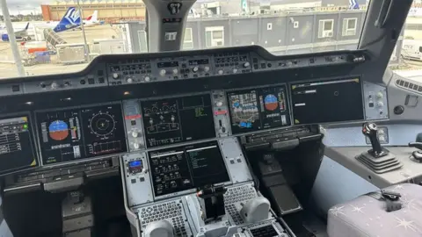
Onboard Sensors in Autopilot
GPS: Position and velocity.
Gyroscope: Angular velocity.
Airspeed Sensor: Measures dynamic pressure.
Magnetometer: Determines heading.
LIDAR & Sonar: Altitude and proximity.

Slide 8
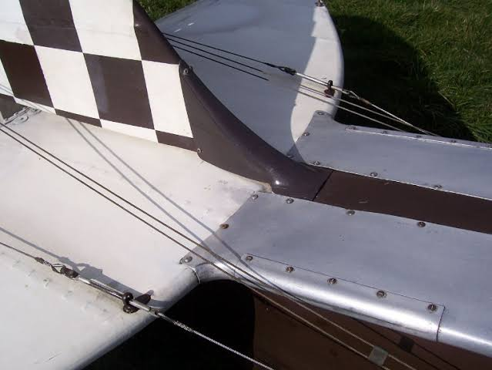
Flight Control Systems (Fly-by-Wire)
Replaces mechanical linkage with electrical signals.
Improves safety and reduces weight.
First fully implemented in the F-16 (1973).

Slide 9
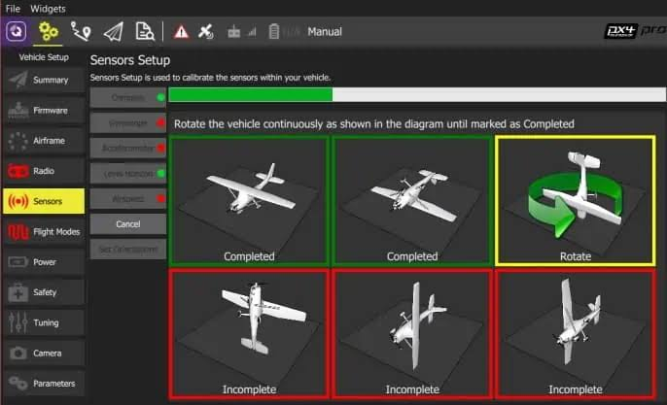
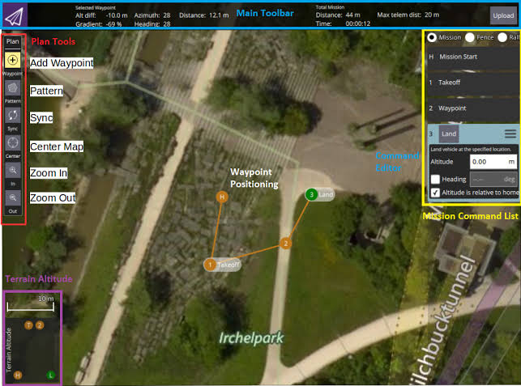
Open-Source Autopilot Software
PX4, Dronekit, and ArduPilot are widely used for UAVs.
Helps with UAV navigation and automation.

Slide 10
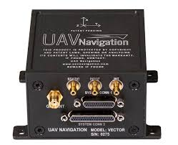
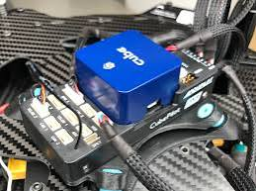
Autopilot Hardware for UAVs
VECTOR-600: High reliability and sensor redundancy.
Pixhawk Series: Popular for drone autopilots.

Slide 11
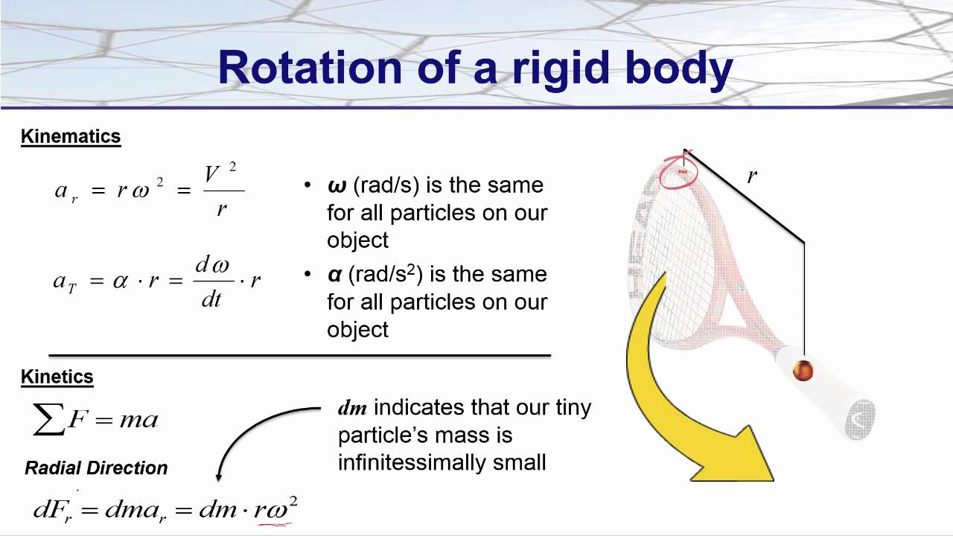
Flight Mechanics & Equations of Motion (EOM)
Rigid Body Dynamics (RBD) equations describe motion.
EOM includes translational & rotational motion.
Various mathematical representations: Euler angles, DCM, Quaternions.

Slide 12
Additional Concepts in Flight Mechanics
Pitch Angle vs. Angle of Attack:
Pitch angle: Angle between the aircraft and the horizon.
Angle of attack: Angle between airflow and the wing chord line.
Sideslip Angle vs. Heading Angle:
Sideslip: Measures yaw misalignment.
Heading: Direction relative to North.

Slide 13
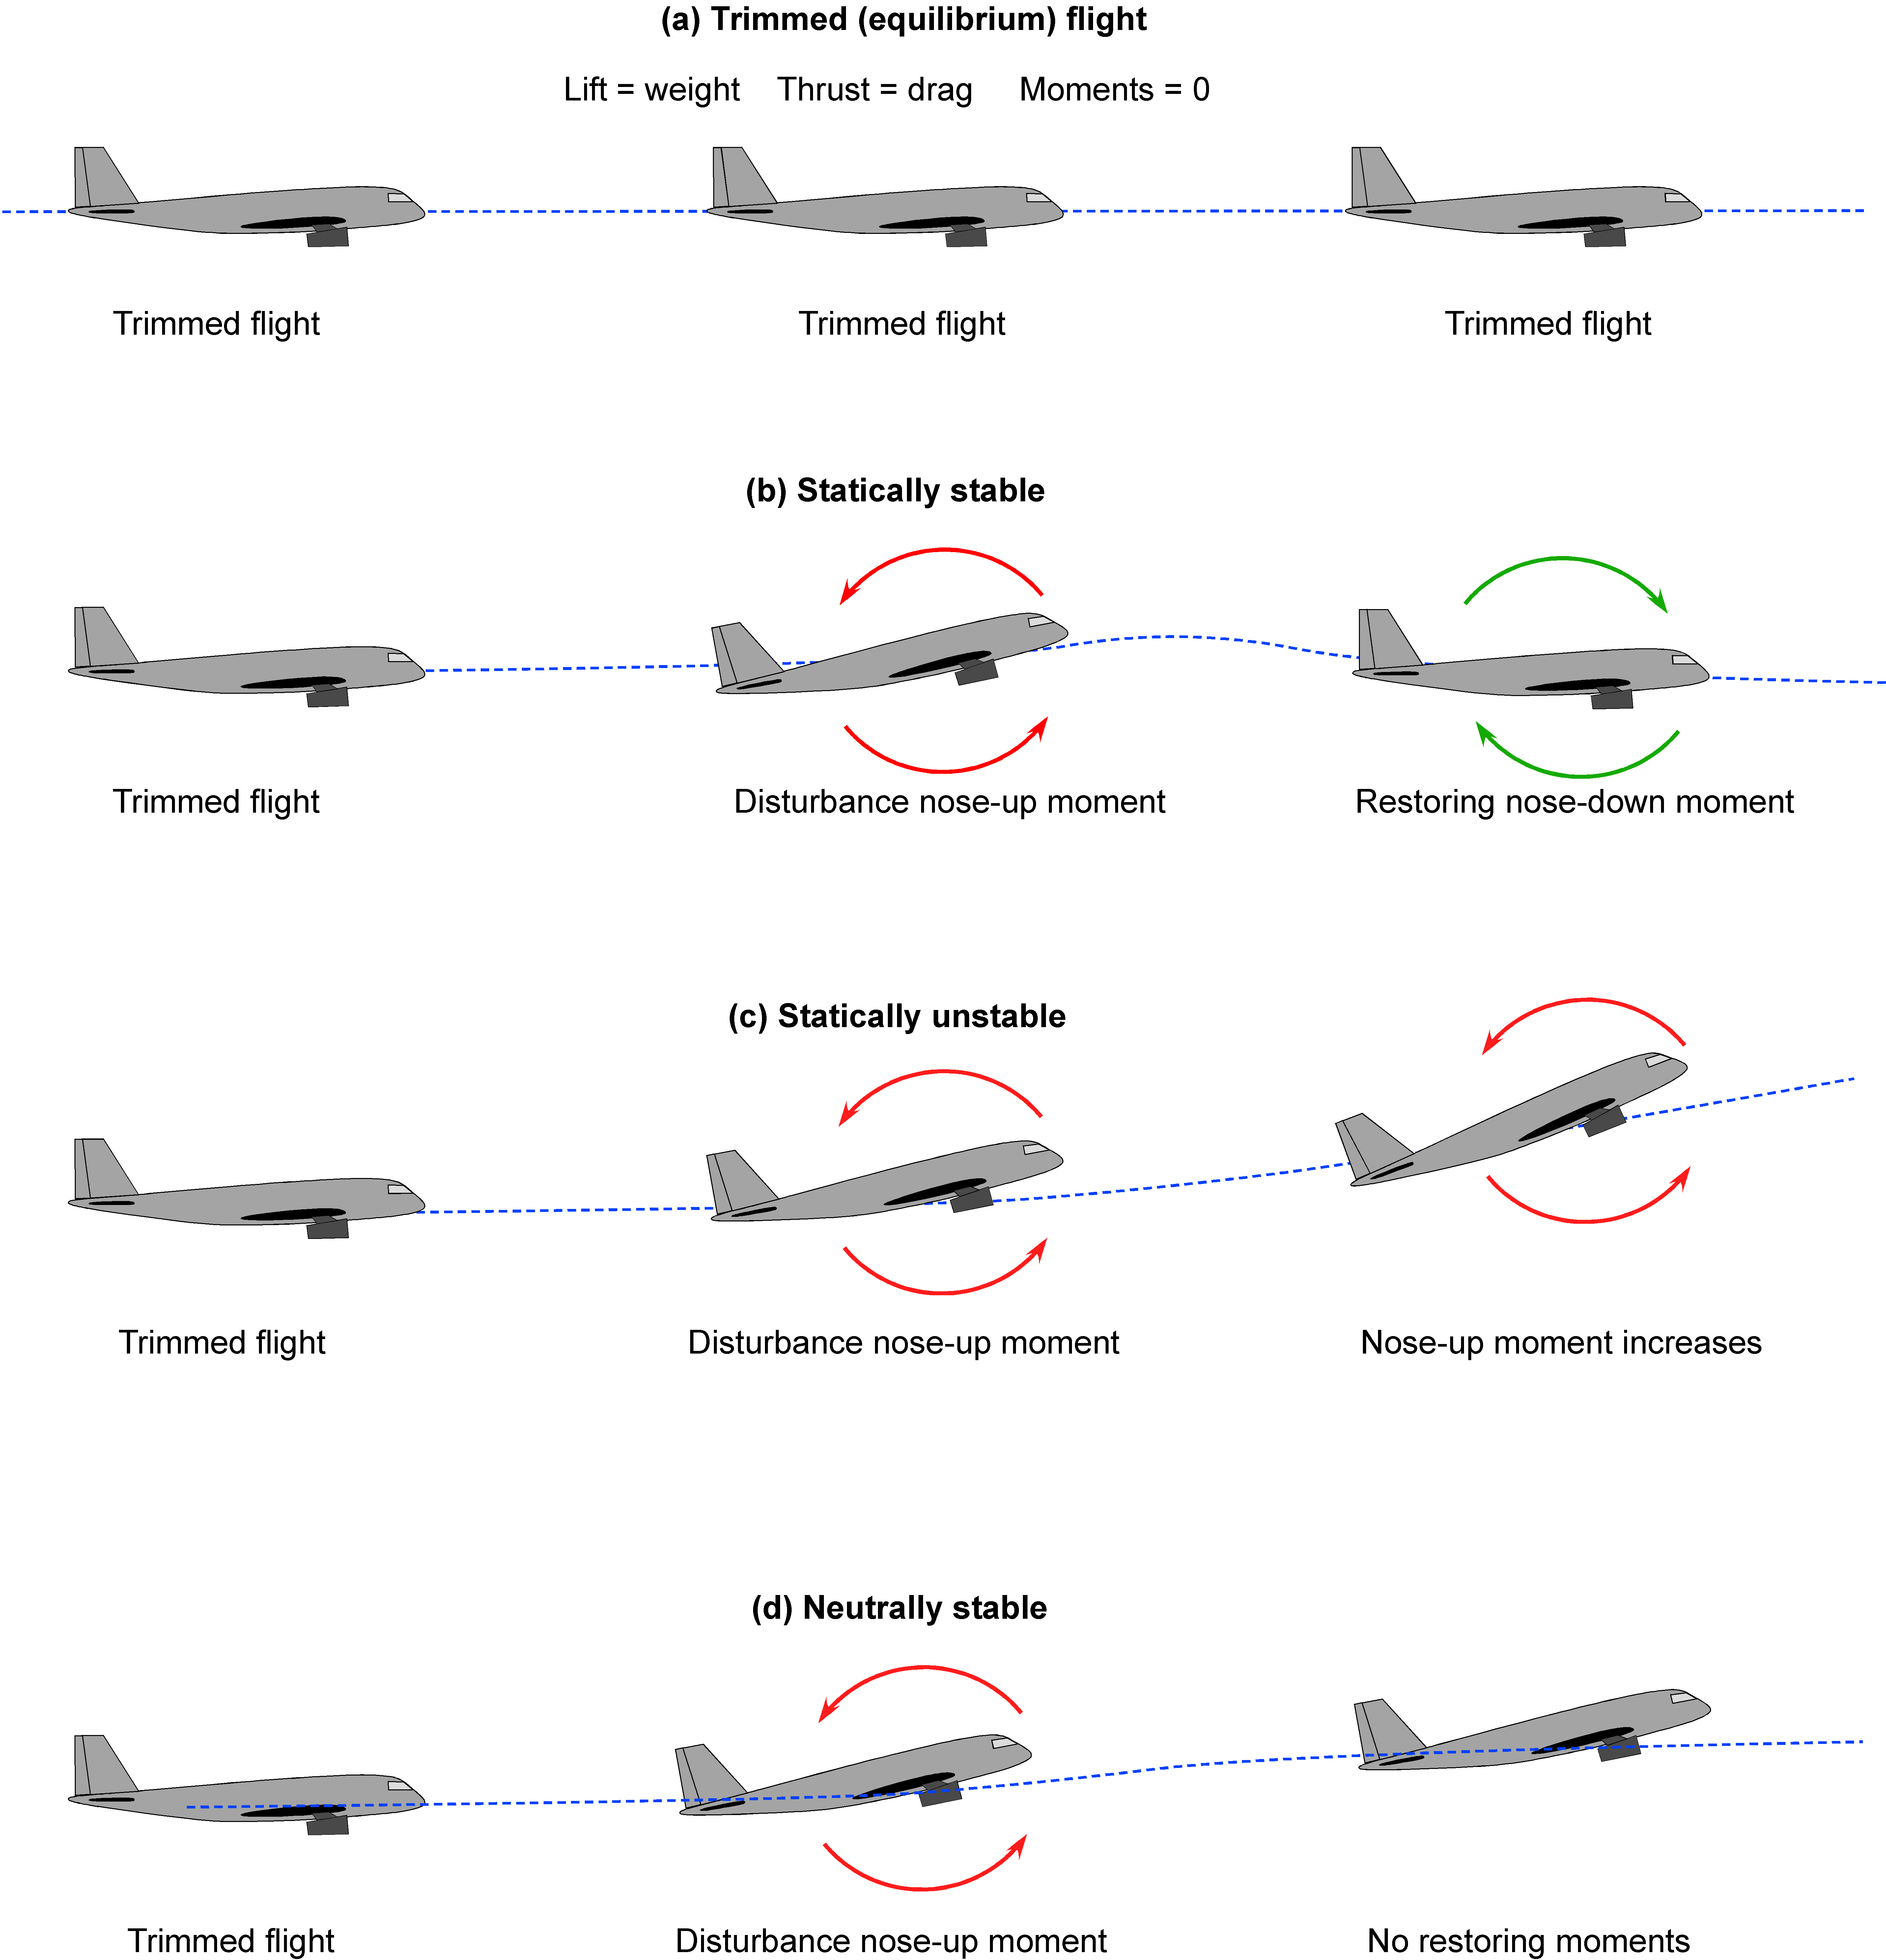
Stability and Control in Flight Mechanics
Longitudinal Stability: Ensures pitch stability.
Lateral Stability: Helps maintain wings-level flight.
Directional Stability: Maintains straight flight without yaw drift.
Control Surfaces: Elevator, ailerons, rudder, and their roles in stability.

Slide 14
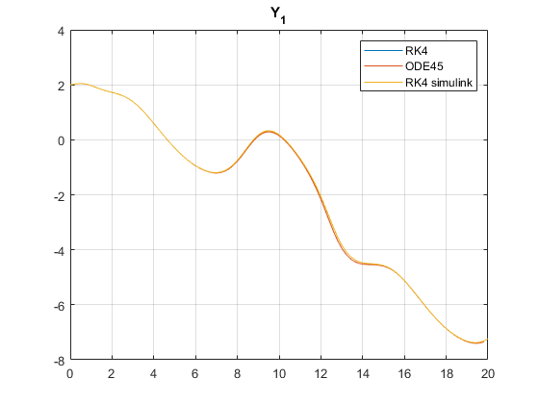
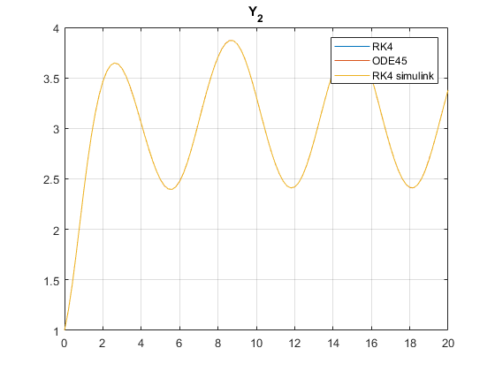
Numerical Solutions of Equations of Motion
Methods used:
Euler’s Method
Runge-Kutta (RK4)
ODE45 (used in MATLAB simulations)
RK4 is commonly used for aircraft motion simulation.

Slide 15
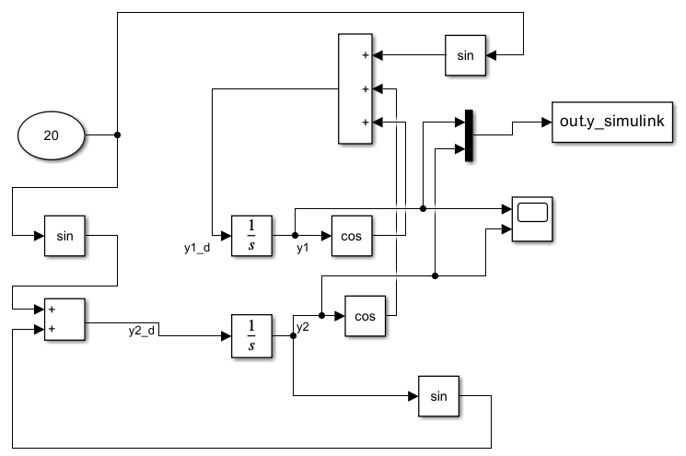
Simulink model

Slide 16
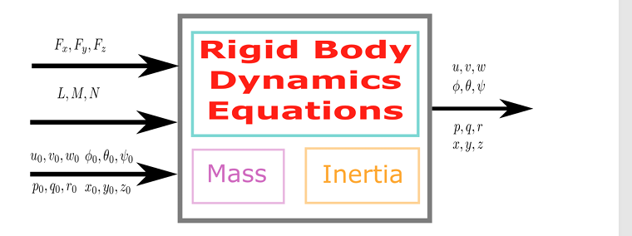
NUMERICAL SOLUTION OF ODE (RK4)

Slide 17
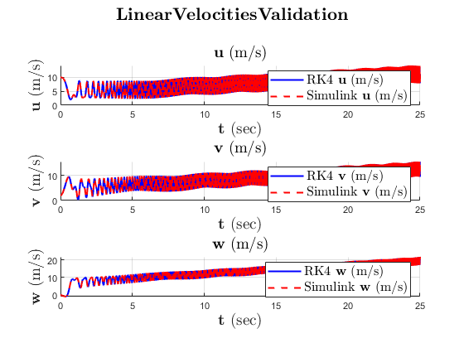
Linear velocities validation

Slide 18
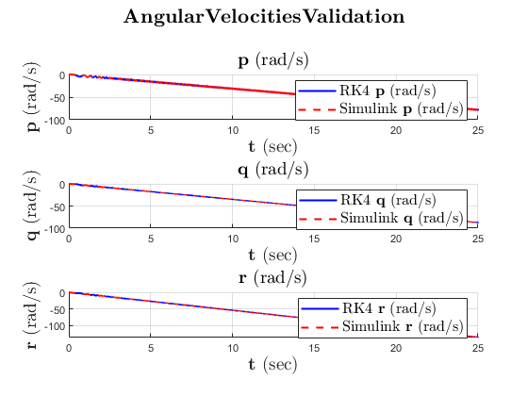
Angular velocities validation

Slide 19
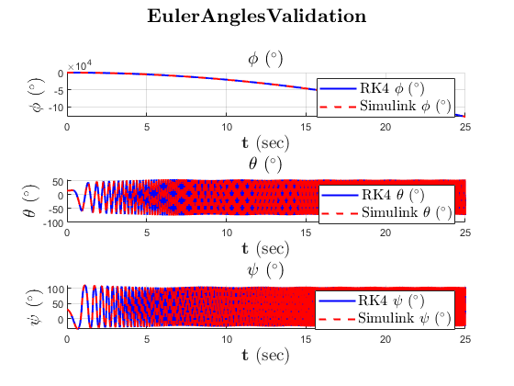
Euler velocities validation

Slide 20
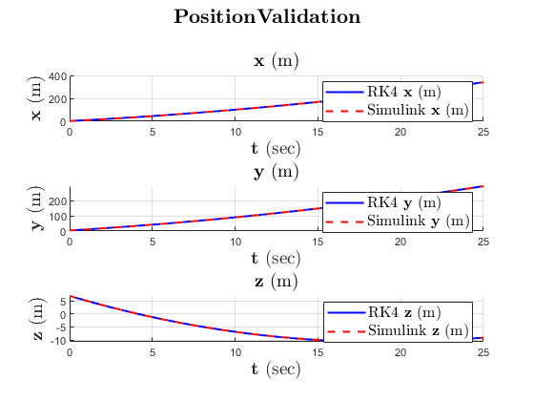
Position validation

Slide 21
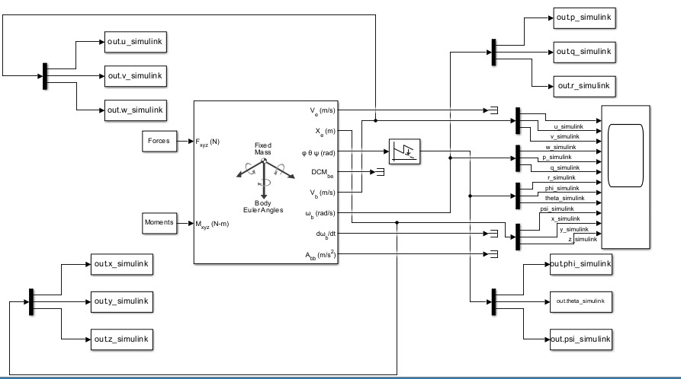
Simulink Graph

Slide 22
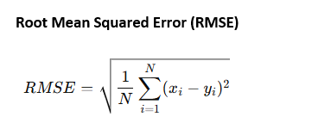
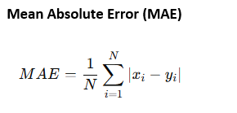
To compare two signals

Slide 23
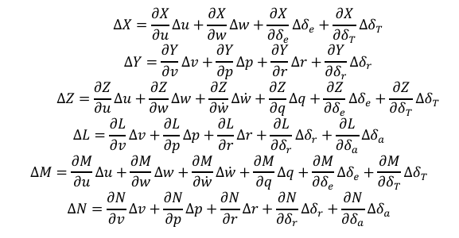
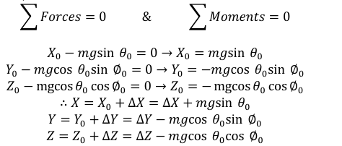
AIRPLANE SIMULATOR
Forces
Equilibrium state

Slide 24
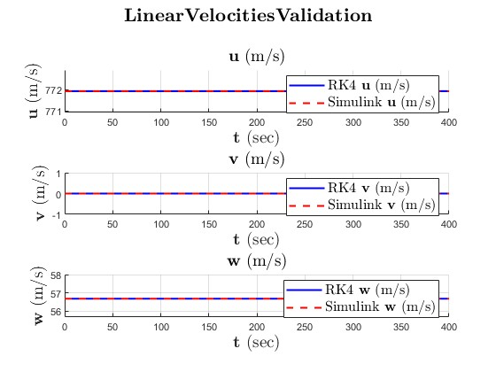
Linear Velocities

Slide 25
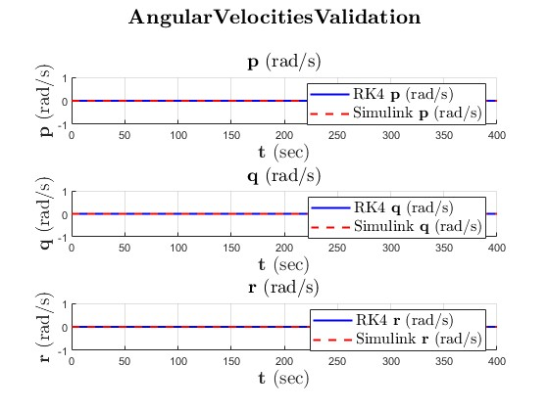
Angular Velocities

Slide 26
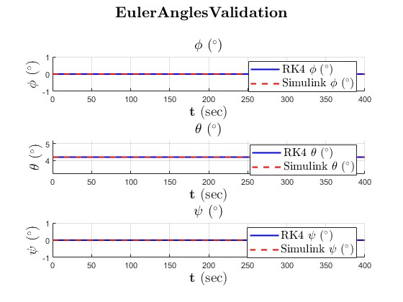
Euler Angels

Slide 27
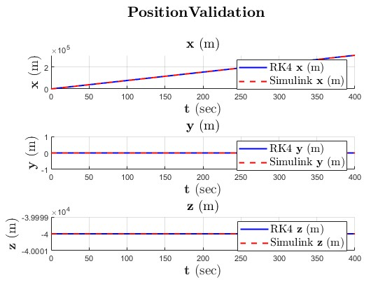
Position Validation

Slide 28
Linearization and Approximation
Fixed wing motion equations
Linearization
Decoupling
Short period approximations
Long period approximations

Slide 29
Linearization and Approximation
Lateral and longitudinal dynamics
Linear full model
Root locus
Bode plot
Models’ inputs
Delta aileron
Delta rudder

Slide 30
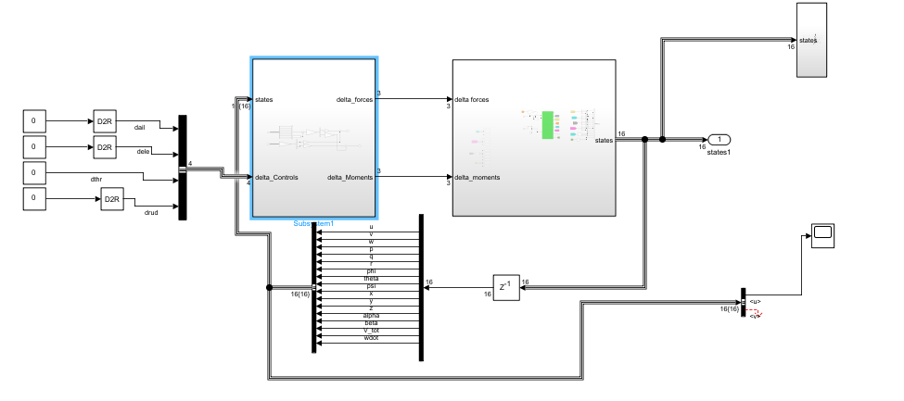
Simulink Model

